Slide 1
Robotics Project
Salvatore Saputo, Deuce Lee, David Vozzo

Slide 2
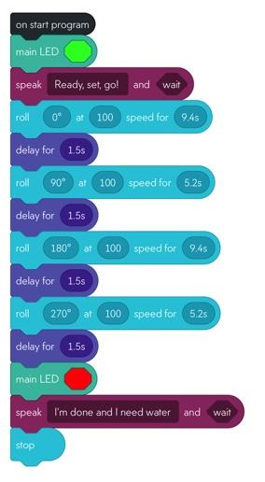
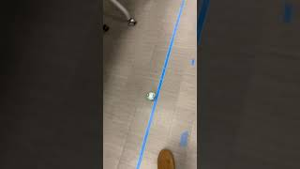
Sprint 1 Endurance

Slide 3
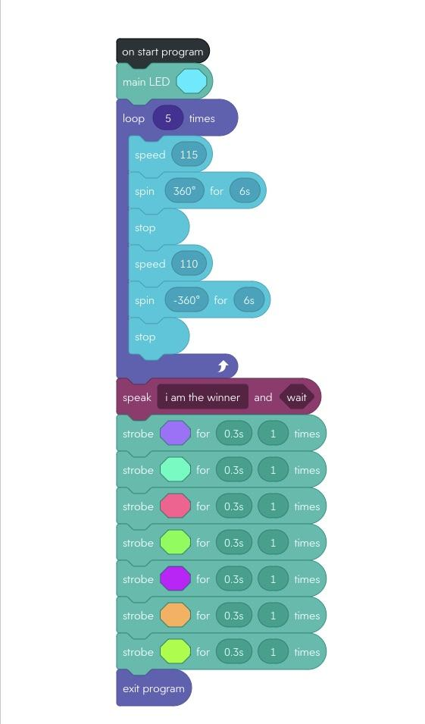
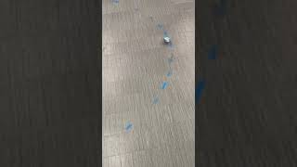
Sprint 2 Accuracy

Slide 4
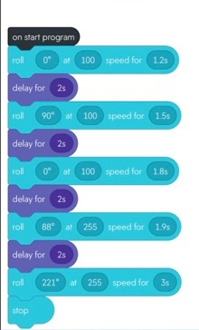
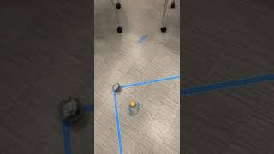
Sprint 3 Agility

Slide 5
Changed we would make
One change that as a group we would make is to be more organized with our planning. This is because we had a hard time finding a time to do the project with all group members present do to conflicting schedules. This lead to confusion and miscommunications within the group. Another change that we would make as a group is to be more diligent while doing the sprints and the system design documents. This is because we made many errors that could have easily been corrected in both, this would have saved us a lot of time and have been very effective in the total outcome of our project.

Slide 6
Challenges Faced
We faced many challenges while conducting the sprints. The biggest problem we faced was the objects on the floor that would disrupt our sprint attempts. Such as chairs, desks and outlets on the floor. Another issue that we faced was getting all three members together and having the room to ourselves, as there were many groups also doing the same assignment in the room and other classes going on. Lastly the challenge we faced was the calibration of the sphero before each sprint. We discovered that if the Sphero was not collaborated and aimed perfectly the sprint would most likely fail and end with the sphero going off course or hitting objects in the classroom.

Slide 7
What we learned
Software engineering is no easy task. Collaboration is key to the success of any project, team members must be able to carry out various tasks like a well oiled machine. No job is to big or too small because in reality if one thing is missing, the project will not be up to par. Attention to detail is also very crucial in this field. The amount of planning and foresight that is put into the project is too much to just skip over small steps, everything has to be right. While you must have attention to detail, software engineering is very tedious and it is almost guaranteed that you will make mistakes, have to restart, or reevaluate your plan. Patience is very key for the engineers.

Slide 8
Member roles
Gantt Chart- all team members
Requirements table - David
Algorithm - Sal
Flowchart- Deuce
Block Code- Sal
Sensor data diagram - Sal
Test table - David
Staffing plan- Deuce
System design doc - All team members
Video - All team members
Github repository- Sal

